Slide 1
Noah Hahn’s Co-Op Presentation
Infrastructure IT
August 10, 2022

Slide 2

Background
Noah Hahn
Incoming Junior at Texas A&M
Majoring in Computer Engineering
First Co-op
Supervisor is John Smitherman
Mentor is Darren Hokanson

Slide 3
Prior Experience
Coursework
Intro to Digital System Design (ECEN 248)
Electrical Circuit Theory (ECEN 214)
Program Design & Concepts (CSCE 120)
Languages:
C++
Windows Command Console
Notes:
Some of my classes that I have taken that helped me this term included Intro to Digital System Design, Electrical Circuit Theory and Program Design & Concepts. I also have previous experience with C++, Windows Command Console.

Slide 4
Overview of Work
Alky 2 Analyzer Building
AIT
Diagram/Implementation
Foyer Compaq Cabinet Removed
Before/After
Server/Software Upgrades
Gen 8 Server Upgrade
Applied Patches
Upgraded VMWare vCenter server
Notes:
I will first talk about my Akly 2 Analyzer building project, then the removal of a Compaq cabinet in the Foyer, and finally my work with servers and software upgrades.

Slide 5
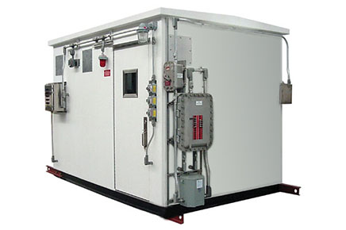
Alky 2 Analyzer Building
Introducing 2 additional analyzer transiters (AITs) to Pipe Stills 3B (PS3B)
Task:
Install and Configure 2 switches and a firewall into Input Output Room (IO Room)
Install and Configure 2 switches into Analyzer building
Tie all installed devices onto level 1 and 3 networks
Analyzer Building
Notes:
Alky 2 is introducing 2 additional AIT’s or Analyzer Transmitter to their Pipe stills 3B unit. Our task was to configure and install 2 switches and a firewall in the units Input output room or IO room, which houses all input and output devices that are tied to machines in the unit, and an additional 2 switches in the analyzer building, which will help send information from the field to those in control rooms. We were then tasked with tieing the devices into the units Level 1 and Level 3 networks.

Slide 6
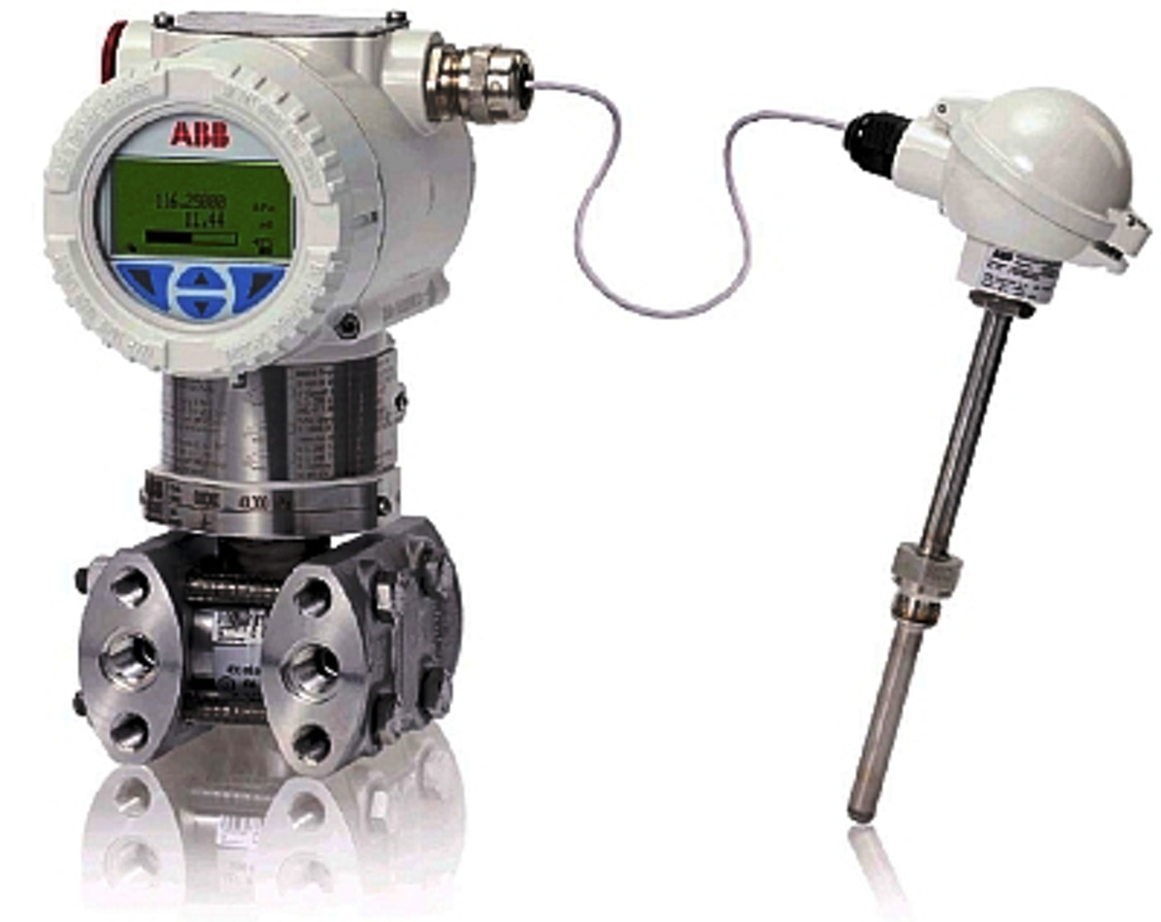
Alky 2 Analyzer Building - AIT
What are Analyzer Buildings for?
Brings Important information from field to engineers and board operators
More consistent, accurate and faster completion of engineering products
What is the purpose of this AIT?
Transmit data from PS3B cooling tower to Alky 2 and PS3B Control board
Allows Engineers to monitor Components (Methane, Propane, Propylene, etc.)
Analyzer Transmitter
Notes:
Analyzer buildings are put into the field to help bring important information from the field like alarms, component levels, and pipe pressures be sent to Engineers and board operators. This data will help create more consistent, accurate, and faster completion of engineering products.
The new AITs main purposes will be to transmit data from the Pipe Stills 3B cooling tower analyzer to the Alky 2 and Pipe stills 3B control board. From here the engineers at the boards can monitor levels of components such as methane , propane, and propylene.

Slide 7
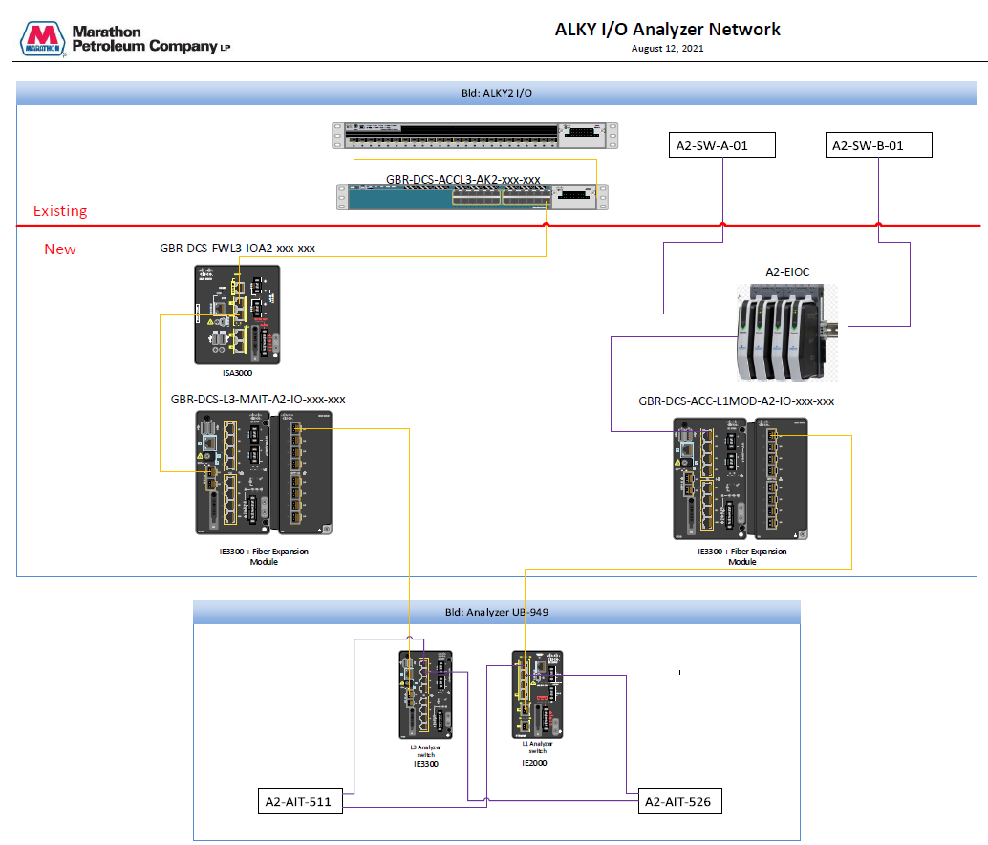
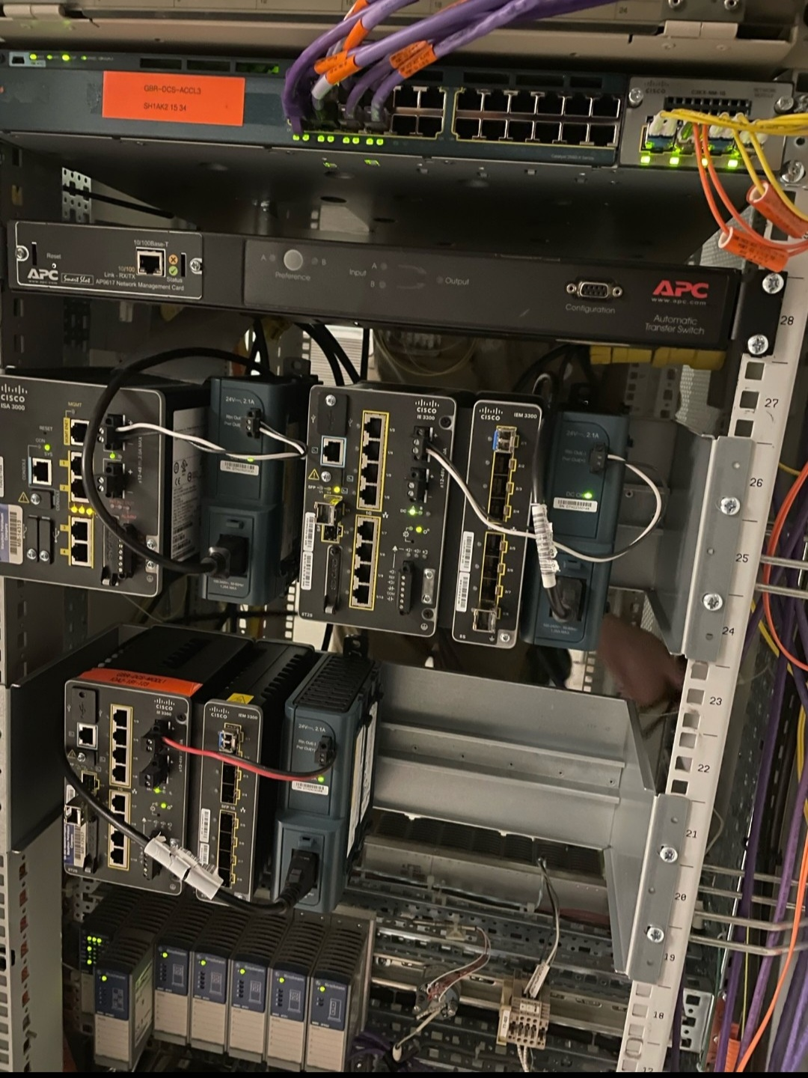
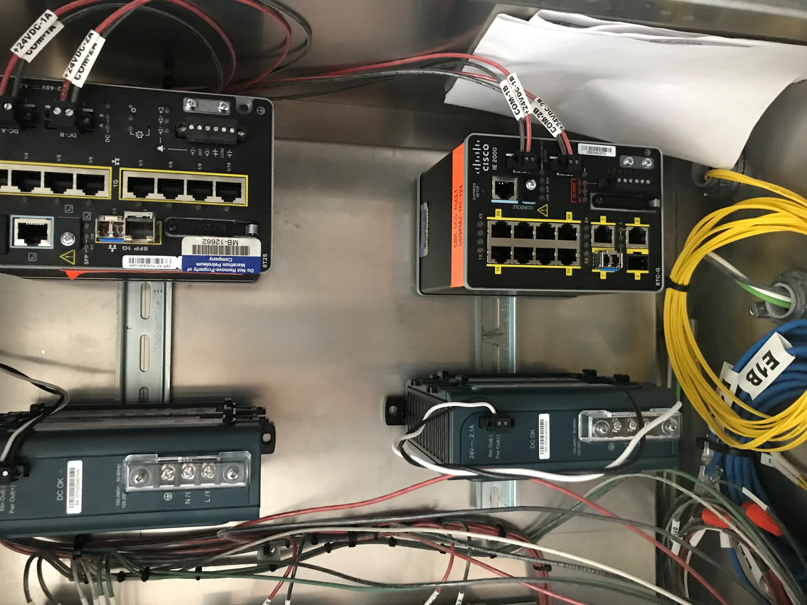
Alky 2 Analyzer Building – Diagram/Implementation
IO Room
Analyzer Building
Notes:
On the left is the Diagram that was created to help show what needs to be done and the right 2 pictures show what it looked like after being installed.
Data will come in from these two switches in the analyzer building and will be sent to their desired destination through the other switches and firewall installed.

Slide 8
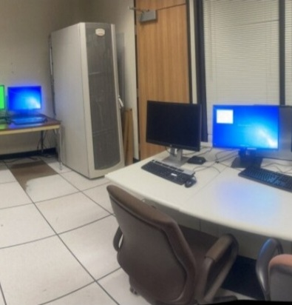
Network/Server Cabinet Consolidation
Installation of 2 new cabinets for upcoming ABB project to house new equipment
Old Compaq cabinet will need to be removed
Task:
Move workstations & servers to a temporary location
Relocate all connections from switch in cabinet
Houses critical systems (Expertune, Triconex, HRVOC Analyzers)
Solution:
Temporary switch allowed systems to stay active during installation of new cabinets
Worked with Process Support Team to monitor alarms
Worked With Fiber Team due to cables being run under the floor tiles
Notes:
An upcoming ABB project requires the installation of 2 new networking cabinets to house new switches, servers, and workstations. To complete this requirement, an old Compaq cabinet needed to be removed to make room for the new equipment.
Our team was tasked with removing all workstations, servers currently housed in the Compaq cabinet to a temporary location. Additionally, we relocated all ethernet connections from a Cisco switch housing critical systems such as Expertune and Triconex to a temporary switch in a nearby location. This temporary switch would allow for connections to stay active during the installation of the new cabinets and equipment.
This effort took a lot of coordination with the Process Support team , who monitored for alarms while relocating connections. Additionally, we worked closely with the Fiber team as some of the ethernet cables that needed to be relocated, run under the floor tiles.

Slide 9
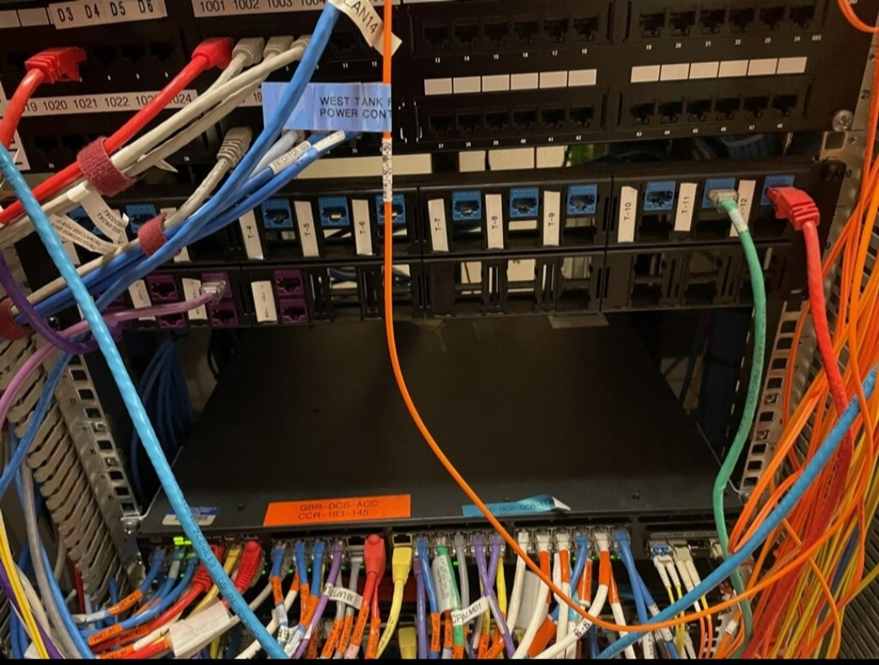
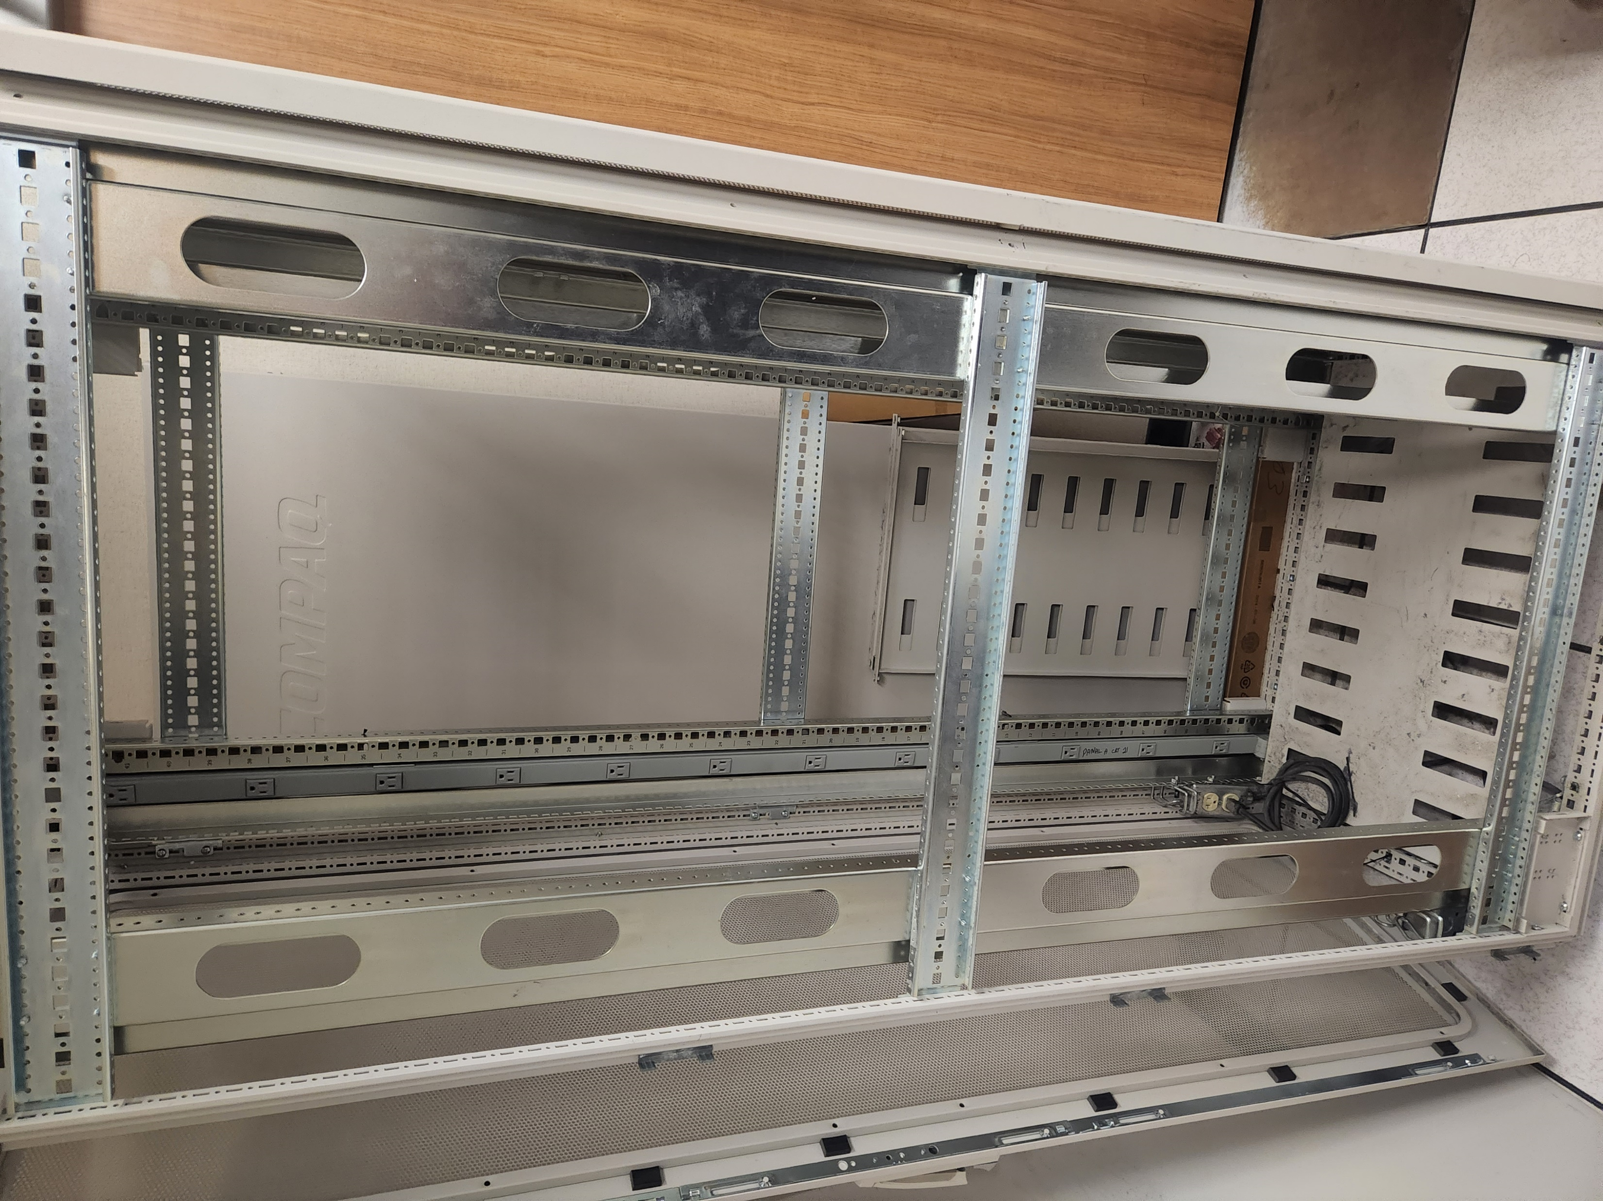
Foyer Compact Cabinet Removed – Before/After
Notes:
Left is a picture of inside cabinet before the removal of equipment
We had to trace and map where these ethernet and fiber cables went, then execute the plan we had created to move them to their temporary spots.
Right is after the cabinet had been emptied

Slide 10
Server/Software Upgrades
Server upgrade/refresh
Built ten HP ProLiant Gen10 servers
Utilized Acronis Cyber Protect to re-image servers to new hardware
REG-WKS-Server ()
TXCOPC03 (OPC server)
Windows Server Security Patching
CSG4 (Cyber Security Group 4) for PI and other PI related servers
CSG2 (Cyber Security Group 2) for Emerson DeltaV DCS System
Upgraded VMWare vCenter server from 6.7 to 7.0
Notes:
Some of my shorter projects I worked on included building Gen 10 servers and upgrading some of our Gen 8 servers by restoring server backups onto the new Gen 10 machines. Applied Patches to CSG2 and CSG4 for PI, PI Related servers, and for Emerson’s DeltaV DCS System As well as upgraded our VMWare vCenter server from 6.7 to 7.0 which helps manage our virtual environment.
vCenter is manager for all virtual environment systems

Slide 11
Experience Gained During Co-op Term
Tools:
Visio (Network Diagraming)
Putty (Remote Access)
WSUS (Patching Tool)
XIA (Asset Inventory)
vCenter Server
Acronis Cyber Protect (Backup/Restore)
Skills
Troubleshooting server OS issues
Configure and installing switches/firewalls
Collaborating with other teams
Creating network diagrams
Deeper network understanding
Notes:
WSUS Windows Server Update Service

Slide 12
My Co-op Experience
What I liked about working at Marathon:
Work environment
Introduction to work force
What Marathon could improve for future co-ops:
More intern events
Better informed on the projects we will be working on
1-5 final rating scale on PDP

Slide 13

Questions?

